Slide 1
Strategy: A View From the Top
Ch. 8: Global Strategy Formulation
Meghan Davidson
Berklye Dominguez
Justin Pickard
Michael Simpson
Andrew Vargas

Slide 2
Global Strategy Formulation
“Going Global”
Global Strategies are rare
Coca-Cola
McDonalds
Other companies

Slide 3
Chapter Preview
Key factors that drive industry globalization
Formulation of global strategies at the microeconomic, corporate, level.
Unique risks associated with operating on a global scale and how to mitigate those risks.

Slide 4
Globalization and Industrial Clustering
Some regions are more efficient than others in producing goods
Industry Advantages
Other Industries
Clustering is the natural outcome of economic forces.
Semiconductor industry

Slide 5
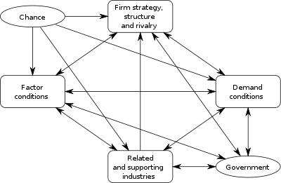
Porters National Diamond

Slide 6
Porter’s National Diamond
Factor Conditions:
Natural vs. Created
Demand Conditions
Size
Related and Supporting Industries
Competitiveness in the Home Industry
Porters 5 Forces (chapter 3)

Slide 7
Porter’s National Diamond
Public Policy (government)
deregulation
Local, regional, national
Chance
Outside the control of the firm

Slide 8
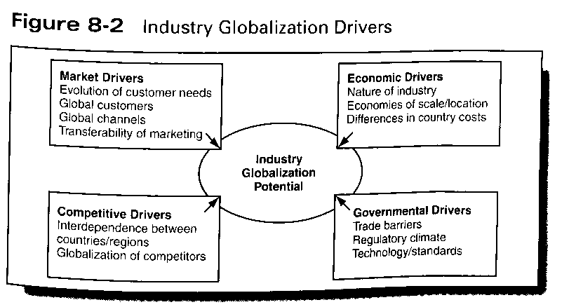
Industry Globalization Drivers

Slide 9
Market Drivers
Forces that push companies to think more globally to challenge competition
Regional or global similarity in product or service calls for a global product.
Ex. Coca Cola and adapting to local markets
Global Branding and Marketing important to success

Slide 10
Cost Drivers
Minimum sales volume required for cost efficiency no longer available in one country
Economies of Scale have become critical for Global success. This creates need for critical mass in different parts of the value chain
Ex. Pharmaceutical companies and R&D

Slide 11
Competitive Drivers
Globalization potential of an industry influenced by competitive drivers such as:
(1)High levels of trade
(2)Competitor’s Diversity
(3) Interdependence created between competitive strategies
Useful Questions:
Do we face the same principle competitors in different parts of the world?
How many competitive arenas does our company compete in?

Slide 12
Government Drivers
Some Industries regulated more than others
Ex. Steel Industry and barriers
Companies paying attention to nonmarket dimensions
Leads to companies trying to shape the global competitive environment to their advantage

Slide 13
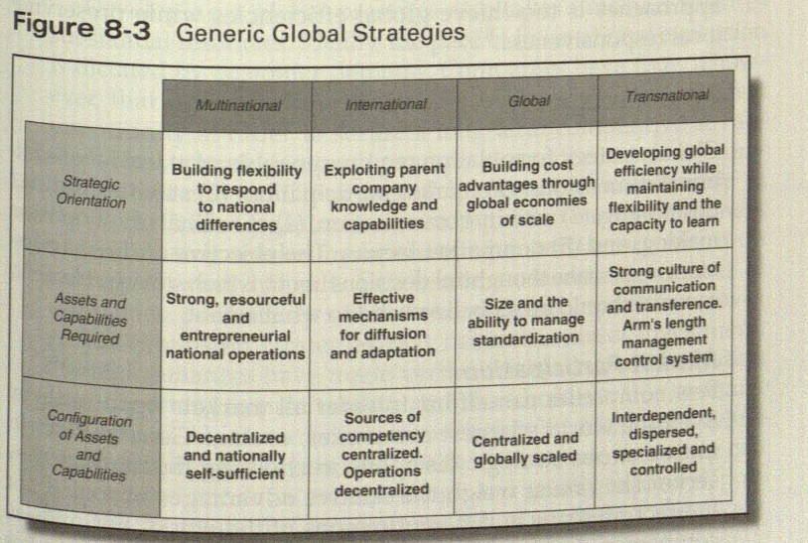
Global Strategy Formulation

Slide 14
Global Strategies Dimensions
There are Five additional Dimensions which are: (1) Market Participation
(2) Standardization/Positioning
(3)Activity Concentration
(4) Coordination of Decision Making, and
(5) Nonmarket Factors.

Slide 15
Market Participation
Few companies can afford to enter all markets open to them.
Distinguish between “must” markets and “nice-to–be-in” markets
Must: compete in to realize global ambitions (Volume perspective)
Nice-to-be-in: participation is desirable but not critical
Pace of international expansion is dictated by customer demand
Ex. Toyota Prius release date in Japan and U.S.

Slide 16
Standardization/Positioning
Primary motivations for standardization: Reducing cost and enhancing quality
Adopt a more global market positioning
Not necessarily mean standardizing all elements of the marketing mix, but by applying a global cost benefit approach to formulate the market strategy and seek balance flexibility with uniformity
The use of global branding helps build in brand recognition, enhance customer preference and reduce worldwide marketing cost
Ex: Nestle, Coca-cola, Ford, IBM and Disney

Slide 17
The Global Branding Strategy Matrix
Message
Standardized Tailored
Global Mix | Global Offer
Global Message | Global Change
Standardized
Offer
Tailored

Slide 18
Global Branding Strategy Matrix
Global (Marketing) Mix: Strategy under which both the offer and the message are the same
Are relatively rare because only a few industries are truly global
This applies when: Product's usage patterns and brand potential are homogeneous on a global scale, when scale and scope cost advantages substantially outweigh the benefits of partial or full adaptation, and when competitive circumstance are such that a long-term sustainable advantage can be secured using a standardize approach

Slide 19
Global Branding Strategy Matrix
Global Offer: strategy characterized by and identical offer but different positioning around the world
Applies when fixed costs associated with the offer are high, when key core benefits offered are identical, and when there are natural market boundaries
Advantage-give a degree of flexibility in positioning the product or service for maximum local advantage
Disadvantage- it could be difficult to sustain as customers become increasingly global in their outlook and confused by the different messages in different parts of the world
Example Holiday Inn

Slide 20
Global Branding Strategy Matrix
Global Message: strategy under which the offer might be different in various parts of the world but the message is the same
Primary motivation is the enormous power behind crating a global brand
Applies when customers are highly mobile; in which the cost of product or service adaptation is fairly low
Disadvantage-can be risky in the long run because global customers might not find elsewhere what they expect at home
Example: McDonald’s

Slide 21
Global Branding Strategy Matrix
Global Change: strategy under which both the offer and message are adapted to local market circumstances
The most common
Adaptation of both the offer and the message is necessary. Differences in a product’s usage patterns, benefits sought, brand image, competitive structures, distribution channels etc all dictate some form of local adaptation

Slide 22
Activity Concentration
Many factors must be considered in selecting the right level of participation and the location for key value-added activities
Ex: Factor conditions, the presence of supporting industrial activity, the nature and location of the demand for the product, industry rivalry etc.
Example: Eli Lilly
To reduce cost, Lilly expanded their R&D efforts in India and china to include clinical tirals

Slide 23
Coordination of Decision Making
Which markets to participate in, how to allocate resources, and how to compete defines the extent to which globalization has been implemented successfully
Many think that integrating and coordinating activity on a global scale is at least as important as control. This can take the form of leveraging regional cost differentials, sharing key resources, cross-subsidizing national or regional battles for market share, or pursuing global brand and distribution positions

Slide 24
Nonmarket Dimensions
Global corporate success is influenced by nonmarket factors that are governed by social, political and legal arrangements
Different countries have different political, economic, and legal systems and are at different stages of economic development
These differences can have profound implication for the rules that shape global competition and for crafting a global strategy

Slide 25
Entry Strategies
In moving toward a more global strategic posture, there are several choices a company can make. Each of these has their own advantages and disadvantages.
Exporting
Licensing
Strategic alliances and joint ventures
Acquisitions or greenfield startups

Slide 26
Region/Country Analysis
To help companies with thinking through their globalization strategies, there is a five dimensional framework that maps a particular country or region’s institutional contexts.
Political and social systems
Openness
Product markets
Labor markets
Capital markets

Slide 27
How Wal-Mart Went Global
The largest retailer in the world, Wal-Mart Stores, is a great example of a company’s transformation from a domestic company into a major global company.
Wal-Mart has three different operations:
Wal-Mart Stores
Sam’s Clubs
Supercenters

Slide 28
Global Opportunity
Wal-Mart began pursuing globalization in 1991 by the need to grow. Today, almost 25% of its stores are located outside the U.S.
If they kept the stores in the domestic market, it would not be exposed to 96% of the world’s potential consumers.
The committed workforce is a large success for the company. For this, there is a link between growth and its effect on stock price and the morale of the company.

Slide 29
Global Opportunity cont.
Wal-Mart exploited tremendous buying power with dominant suppliers like Hallmark, Proctor & Gamble, Kellogg, Nestlé, Coke, Revlon, and more to procure good cost-effectively for their foreign stores.
The company also took advantage of domestically developed competencies and knowledge in areas of store management, merchandising skills, logistics, and the use of technology.

Slide 30
Target Markets
During the first 5 years of Wal-Mart’s globalization, it focused on their presence in the Americas: Brazil, Mexico, Canada, and Argentina. This was because they realized they didn’t have the resources to expand to Europe and it wouldn’t be a good entry market for them at that point.
In 1996, Wal-Mart felt prepared to target China.

Slide 31
Mode of Entry
After selecting their targets, Wal-Mart had to select a mode of entry.
Entered Canada through an acquisition.
Entered Mexico through a 50-50 joint venture with Cifra.
Entered Brazil through a 60-40 joint venture with Lojas Americana.
Entered Argentina through a wholly owned subsidiary.

Slide 32
Global Transfer of Skills
Wal-Mart acquired the Canadian Woolco and reconfigured it along the lines of a successful U.S. model:
A transition team familiarized Woolco with Wal-Mart’s way
Brought the outlets up to Wal-Mart standards
Brought high brand recognition into customer acceptance and loyalty
Focused on merchandise, high in-stock position, and customer service
Implemented employee rewards

Slide 33
Local Adaptation
Wal-Mart’s entrance into China was a great example of the problems of local adaptation.
Experimented with store designs
Varied merchandise
Began purchasing 75% of goods sold in China

Slide 34
Local Competition
Acquiring a dominant player
Acquiring a weak player
Launching a frontal attack on the incumbent.

Slide 35
Gains and Setbacks
Wal-Mart is continuing to struggle in England.
Wal-Mart had to sell out of the German market after being unable to create the economies of scale needed to dominate the market.

Slide 36
Global Strategy and Risk
Types of Risk
Political Risk
Legal Risk
Financial/Economic Risk
Societal/Cultural Risk

Slide 37
Global Strategy
Wal-Mart used economies of scale and standardization to go global.
Cemex, however, took advantage of differences in global markets in order to grow globally.

